Slide 1
Welcome to
CS 235 Data Structures
Self-balancing Trees (40)
Chapter 11.3 RB Trees, pgs. 656-663.

Slide 2
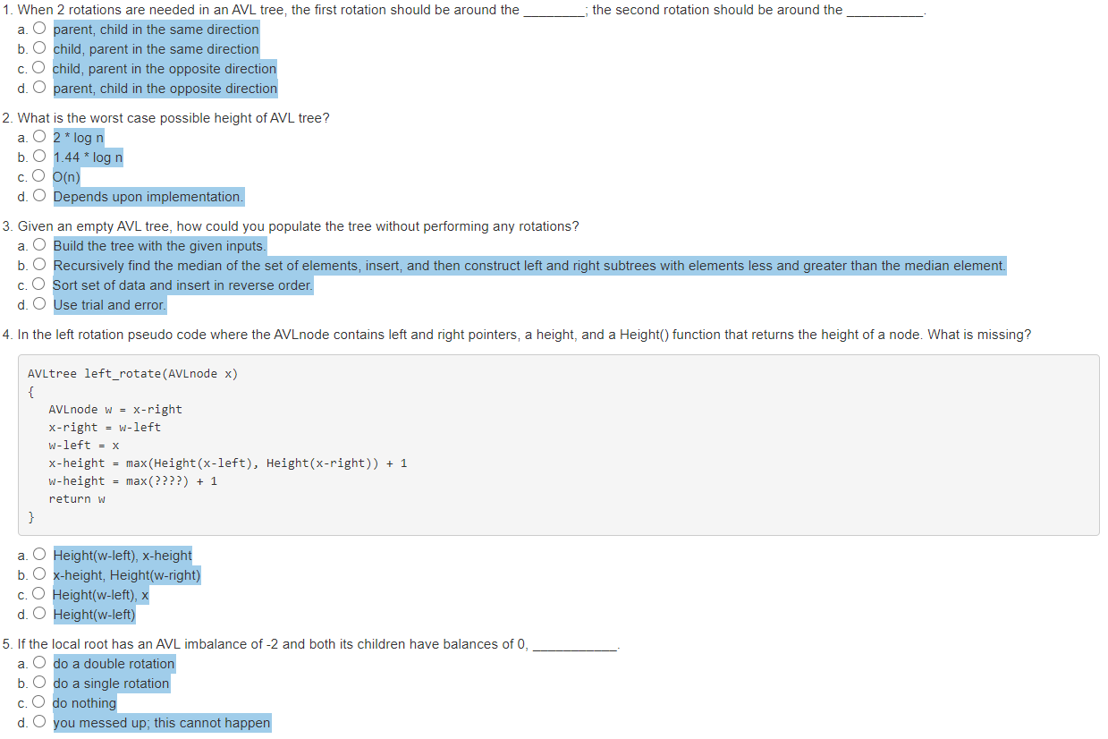
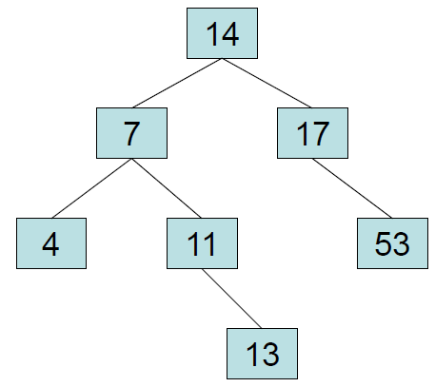
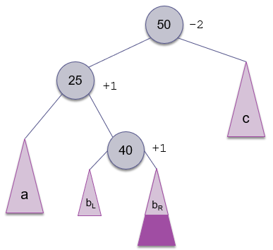
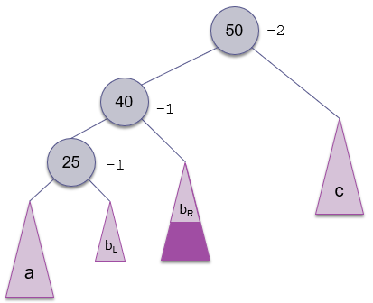
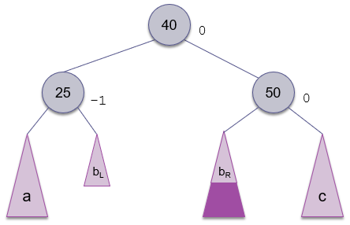
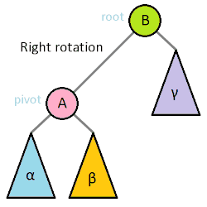
Attendance Quiz #39
A full binary tree of height k can hold 2^{k} - 1 items.
2
AVLtree left_rotate(AVLnode x)
{
AVLnode w = x-right
x-right = w-left
w-left = x
x-height = max(Height(x-left), Height(x-right)) + 1
w-height = max(x-height, Height(w-right)) + 1
return w
}

Slide 3
Tip #40: STL Additions
Recently added algorithms provide more intuitive parameter lists and cleaner interfaces.
For example, copy_if() is a new convenience algorithm that selectively copies every element that satisfies some predicate (functor.)
In the following example, copy_if() copies only the positive numbers from the range [first, last) to result:
#include <algorithm>
struct ispositive // predicate functor
{
bool operator()(int val) const
{
return val > 0; }
};
int first[10] = { 0, -1, -2, 3, 4, -5, -3, 6, 3, -7 };
int result[10] = { 0 }; // set all 10 values to 0
copy_if(first, first + 10, result, ispositive());

Slide 4
QuickSort Stats
virtual int medianOfThree(size_t left, size_t right)
{
if ((left >= right) || (left > size_) || (right > size_) || (size_ == 0))
return -1;
return bubble_sort3(left, right);
}
size_t bubble_sort3(size_t first, size_t last)
{
size_t middle = first + (last - first) / 2;
if (++comparisons_ && (sort_array_[middle] < sort_array_[first]))
swap(first, middle);
if (++comparisons_ && (sort_array_[last - 1] < sort_array_[middle]))
swap(middle, last - 1);
if (++comparisons_ && (sort_array_[middle] < sort_array_[first]))
swap(first, middle);
return middle;
}
void swap(size_t x, size_t y)
{
T temp = sort_array_[x];
sort_array_[x] = sort_array_[y];
sort_array_[y] = temp;
++exchanges_;
return;
}

Slide 5
11.3 Red-Black Trees
Insertion into a Red-Black Tree
Removal from a Red-Black Tree
Performance of a Red-Black Tree
11.3, pgs. 643-656

Slide 6
Red-Black Trees
A Red-Black tree is a special case of a B-Tree developed by Rudolf Bayer and late refined by Leo Guibas and Robert Sedgewick.
Properties of a Red-Black tree include:
Each node of the binary tree has an extra bit (red or black) which are used to ensure the tree remains approximately balanced during insertions and deletions.
Balance is preserved by always satisfying certain properties, which collectively constrain how unbalanced the tree can become in the worst case.
When the tree is modified, the new tree is efficiently rearranged and repainted to restore the coloring properties.
The balancing of a Red-Black tree is not perfect, but it is good enough to guarantee searching in O(log n) time.

Slide 7
Red-Black Trees
A Red-Black tree maintains the following invariants:
Every node is either red or black.
The root node is always black.
Every red node must either have zero or two black children.
Every root-null path much have the same number of black nodes.
Height = 4
Height = 2
11
2
14
1
7
Height is determined by counting only black nodes.
A Red-Black tree is always balanced because the root node’s left and right subtrees must be the same height.
Red-Black tress are mostly balanced.
Worst cast, red nodes can make one side double the height of the other side.
5
8
Is this an AVL tree?
Is this a Red-Black tree?

Slide 8
Which of these trees are 1) AVL and/or Red-Black trees? Why or why not?
11
Not AVL
Red-Black
20
Not AVL
Not Red-Black
2
14
10
40
1
7
5
15
5
8
Invariants:
Every node is either red or black.
The root node is always black.
Every red node must either have zero or two black children.
Every root-null path much have the same number of black nodes.
7
20
AVL
Not Red-Black
20
10
40
5
15
AVL
Red-Black
10
40

Slide 9
Red-Black Trees
Inserting into a red-black tree is a two-step process:
Insert the new node like you would with a normal BST. The new node always starts out red.
Use recoloring of parents/siblings first. If recoloring doesn't work, then use rotations to balance the tree.
There are five cases, when inserting a new node:
Case 1: Inserting the first node.
Case 2: The new node’s parent is black.
Case 3: Both the parent and the uncle (parent's sibling) are red.
Case 4: The parent is red and the uncle is black and the node and parent are in a right-left or left-right configuration.
Case 5: The parent is red and the uncle is black and the node and parent are in a right-right or left-left configuration.

Slide 10
Insertion into a Red-Black Tree
The algorithm follows the same recursive search process used for all binary search trees to reach the insertion point.
New item is inserted (at leaf) and initially given the color red.
If the parent is black, we are done; otherwise try recoloring of parents/siblings first, then use rotations to balance the tree.
Three situations ("cases") that may occur after an insertion:
Parent and uncle are red (toggle colors.)
Parent is red and has no uncle (1 rotation for L-L or R-R.)
Parent is red and has no uncle (2 rotations for L-R or R-L.)
Move up tree and fix balance as needed.
No need to keep track of depth along each branch (like AVL trees.)
In general, Red-Black trees are more efficient than AVL trees.
20
20
20
10
30
30
30
35
35
25

Slide 11
Insertion into a Red-Black Tree
CASE 1
20
Invariants:
Every node is either red or black.
The root node is always black.
Every red node must either have zero or two black children.
Every root-null path much have the same number of black nodes.
10
30
35
Parent and uncle are Red
20
20
20
10
30
10
30
10
30
35
35
35

Slide 12
Insertion into a Red-Black Tree
CASE 2
Invariants:
Every node is either red or black.
The root node is always black.
Every red node must either have zero or two black children.
Every root-null path much have the same number of black nodes.
20
30
Parent is red and has no uncle (1 rotation fixes balance.)
20
20
30
30
30
20
35
35
35

Slide 13
Insertion into a Red-Black Tree
CASE 3
Invariants:
Every node is either red or black.
The root node is always black.
Every red node must either have zero or two black children.
Every root-null path much have the same number of black nodes.
20
30
Parent is red and has no uncle
(1 rotation does not fix balance.)
20
20
30
30
30
20
25
25
25

Slide 14
Insertion into a Red-Black Tree
CASE 3
Invariants:
Every node is either red or black.
The root node is always black.
Every red node must either have zero or two black children.
Every root-null path much have the same number of black nodes.
20
30
Parent is red and has no uncle
(2 rotations required to fix balance.)
20
20
20
25
30
25
25
20
30
25
30
30

Slide 15
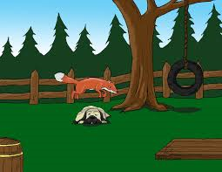
Red-Black Tree Example
Build a Red-Black tree from the words:
"The quick brown fox jumps over the lazy dog."

Slide 16
Red-Black Tree Example
Invariants:
Every node is either red or black.
The root node is always black.
Every red node must either have zero or two black children.
Every root-null path much have the same number of black nodes.
The
The root must be recolored black.
Case 1: Parent and uncle are red
(toggle colors.)
Case 2: Parent is red and has no uncle
(1 rotation for L-L or R-R.)
Case 3: Parent is red and has no uncle
(2 rotations for L-R or R-L.)

Slide 17
Red-Black Tree Example
Invariants:
Every node is either red or black.
The root node is always black.
Every red node must either have zero or two black children.
Every root-null path much have the same number of black nodes.
The
quick
No changes needed
Case 1: Parent and uncle are red
(toggle colors.)
Case 2: Parent is red and has no uncle
(1 rotation for L-L or R-R.)
Case 3: Parent is red and has no uncle
(2 rotations for L-R or R-L.)

Slide 18
Red-Black Tree Example
Invariants:
Every node is either red or black.
The root node is always black.
Every red node must either have zero or two black children.
Every root-null path much have the same number of black nodes.
The
quick
brown
First, rotate so that the child is on the same side of its parent as its parent is to the grandparent
Case 1: Parent and uncle are red
(toggle colors.)
Case 2: Parent is red and has no uncle
(1 rotation for L-L or R-R.)
Case 3: Parent is red and has no uncle
(2 rotations for L-R or R-L.)
Notes:
Node and parent are both red. Node is left child, parent is right child, rotate parent right.

Slide 19
Red-Black Tree Example
Invariants:
Every node is either red or black.
The root node is always black.
Every red node must either have zero or two black children.
Every root-null path much have the same number of black nodes.
The
brown
quick
Second, rotate grandparent left so that the tree is in balance.
Case 1: Parent and uncle are red
(toggle colors.)
Case 2: Parent is red and has no uncle
(1 rotation for L-L or R-R.)
Case 3: Parent is red and has no uncle
(2 rotations for L-R or R-L.)
Notes:
Node and parent are both red.
Node is right child, parent is right child.
Can fix extra redness with a single rotation of grandparent.

Slide 20
Red-Black Tree Example
Invariants:
Every node is either red or black.
The root node is always black.
Every red node must either have zero or two black children.
Every root-null path much have the same number of black nodes.
brown
The
quick
Case 1: Parent and uncle are red
(toggle colors.)
Case 2: Parent is red and has no uncle
(1 rotation for L-L or R-R.)
Case 3: Parent is red and has no uncle
(2 rotations for L-R or R-L.)

Slide 21
Red-Black Tree Example
Invariants:
Every node is either red or black.
The root node is always black.
Every red node must either have zero or two black children.
Every root-null path much have the same number of black nodes.
brown
The
quick
fox
Case 1: Parent and uncle are red
(toggle colors.)
Case 2: Parent is red and has no uncle
(1 rotation for L-L or R-R.)
Case 3: Parent is red and has no uncle
(2 rotations for L-R or R-L.)

Slide 22
Red-Black Tree Example
Invariants:
Every node is either red or black.
The root node is always black.
Every red node must either have zero or two black children.
Every root-null path much have the same number of black nodes.
brown
The
quick
fox
Case 1: Parent and uncle are red
(toggle colors.)
Case 2: Parent is red and has no uncle
(1 rotation for L-L or R-R.)
Case 3: Parent is red and has no uncle
(2 rotations for L-R or R-L.)
Notes:
Node and parent are both red.
Uncle of node is red – push blackness down from grandparent.

Slide 23
Red-Black Tree Example
Invariants:
Every node is either red or black.
The root node is always black.
Every red node must either have zero or two black children.
Every root-null path much have the same number of black nodes.
brown
The
quick
fox
fox's parent and its parent's sibling are both red.
Push blackness down from grandparent..
Case 1: Parent and uncle are red
(toggle colors.)
Case 2: Parent is red and has no uncle
(1 rotation for L-L or R-R.)
Case 3: Parent is red and has no uncle
(2 rotations for L-R or R-L.)
Notes:
Node and parent are both red.
Uncle of node is red – push blackness down from grandparent.

Slide 24
Red-Black Tree Example
Invariants:
Every node is either red or black.
The root node is always black.
Every red node must either have zero or two black children.
Every root-null path much have the same number of black nodes.
brown
The
quick
fox
We can change brown's color to black and not violate #4
Case 1: Parent and uncle are red
(toggle colors.)
Case 2: Parent is red and has no uncle
(1 rotation for L-L or R-R.)
Case 3: Parent is red and has no uncle
(2 rotations for L-R or R-L.)
Notes:
Root of tree is red. Color it black.

Slide 25
Red-Black Tree Example
Invariants:
Every node is either red or black.
The root node is always black.
Every red node must either have zero or two black children.
Every root-null path much have the same number of black nodes.
brown
The
quick
fox
jumps
Case 1: Parent and uncle are red
(toggle colors.)
Case 2: Parent is red and has no uncle
(1 rotation for L-L or R-R.)
Case 3: Parent is red and has no uncle
(2 rotations for L-R or R-L.)

Slide 26
Red-Black Tree Example
Invariants:
Every node is either red or black.
The root node is always black.
Every red node must either have zero or two black children.
Every root-null path much have the same number of black nodes.
brown
The
quick
fox
jumps
First, rotate so that the child is on the same side of its parent as its parent is to the grandparent
Case 1: Parent and uncle are red
(toggle colors.)
Case 2: Parent is red and has no uncle
(1 rotation for L-L or R-R.)
Case 3: Parent is red and has no uncle
(2 rotations for L-R or R-L.)
Notes:
Node and parent are both red.
Node is right child, parent is left child, rotate parent left.

Slide 27
Red-Black Tree Example
Invariants:
Every node is either red or black.
The root node is always black.
Every red node must either have zero or two black children.
Every root-null path much have the same number of black nodes.
brown
The
quick
jumps
fox
Second, rotate right about quick
Case 1: Parent and uncle are red
(toggle colors.)
Case 2: Parent is red and has no uncle
(1 rotation for L-L or R-R.)
Case 3: Parent is red and has no uncle
(2 rotations for L-R or R-L.)
Notes:
Node and parent are both red. Node is left child, parent is left child.
Can fix extra redness with a single rotation right.

Slide 28
Red-Black Tree Example
Invariants:
Every node is either red or black.
The root node is always black.
Every red node must either have zero or two black children.
Every root-null path much have the same number of black nodes.
brown
The
jumps
fox
quick
Case 1: Parent and uncle are red
(toggle colors.)
Case 2: Parent is red and has no uncle
(1 rotation for L-L or R-R.)
Case 3: Parent is red and has no uncle
(2 rotations for L-R or R-L.)

Slide 29
Red-Black Tree Example
Invariants:
Every node is either red or black.
The root node is always black.
Every red node must either have zero or two black children.
Every root-null path much have the same number of black nodes.
brown
The
jumps
fox
quick
over
Case 1: Parent and uncle are red
(toggle colors.)
Case 2: Parent is red and has no uncle
(1 rotation for L-L or R-R.)
Case 3: Parent is red and has no uncle
(2 rotations for L-R or R-L.)
Notes:
Node and parent are both red.
Uncle of node is read – push blackness down from grandparent.

Slide 30
Red-Black Tree Example
Invariants:
Every node is either red or black.
The root node is always black.
Every red node must either have zero or two black children.
Every root-null path much have the same number of black nodes.
brown
The
jumps
fox
quick
over
Change colors of parent and parent's sibling.
Case 1: Parent and uncle are red
(toggle colors.)
Case 2: Parent is red and has no uncle
(1 rotation for L-L or R-R.)
Case 3: Parent is red and has no uncle
(2 rotations for L-R or R-L.)
Notes:
Push blackness down from grandparent.

Slide 31
Red-Black Tree Example
Invariants:
Every node is either red or black.
The root node is always black.
Every red node must either have zero or two black children.
Every root-null path much have the same number of black nodes.
brown
The
jumps
fox
quick
over
the
No changes needed
Case 1: Parent and uncle are red
(toggle colors.)
Case 2: Parent is red and has no uncle
(1 rotation for L-L or R-R.)
Case 3: Parent is red and has no uncle
(2 rotations for L-R or R-L.)

Slide 32
Red-Black Tree Example
Invariants:
Every node is either red or black.
The root node is always black.
Every red node must either have zero or two black children.
Every root-null path much have the same number of black nodes.
brown
The
jumps
fox
quick
over
the
lazy
Case 1: Parent and uncle are red
(toggle colors.)
Case 2: Parent is red and has no uncle
(1 rotation for L-L or R-R.)
Case 3: Parent is red and has no uncle
(2 rotations for L-R or R-L.)
Case 1: Parent and uncle are red (toggle colors.)
Case 2: Parent is red and has no uncle (1 rotation for L-L or R-R.)
Case 3: Parent is red and has no uncle (2 rotations for L-R or R-L.)
Change colors.
Notes:
Single rotate left.

Slide 33
Red-Black Tree Example
Invariants:
Every node is either red or black.
The root node is always black.
Every red node must either have zero or two black children.
Every root-null path much have the same number of black nodes.
brown
The
jumps
fox
quick
over
the
lazy
Case 1: Parent and uncle are red
(toggle colors.)
Case 2: Parent is red and has no uncle
(1 rotation for L-L or R-R.)
Case 3: Parent is red and has no uncle
(2 rotations for L-R or R-L.)
lazy is OK, but jumps violates Rule #3.
Only one rotation is needed.
Notes:
Single rotate left.

Slide 34
Red-Black Tree Example
Invariants:
Every node is either red or black.
The root node is always black.
Every red node must either have zero or two black children.
Every root-null path much have the same number of black nodes.
jumps
brown
quick
The
fox
over
the
dog.
lazy
Case 1: Parent and uncle are red
(toggle colors.)
Case 2: Parent is red and has no uncle
(1 rotation for L-L or R-R.)
Case 3: Parent is red and has no uncle
(2 rotations for L-R or R-L.)
The tree is balanced.

Slide 35
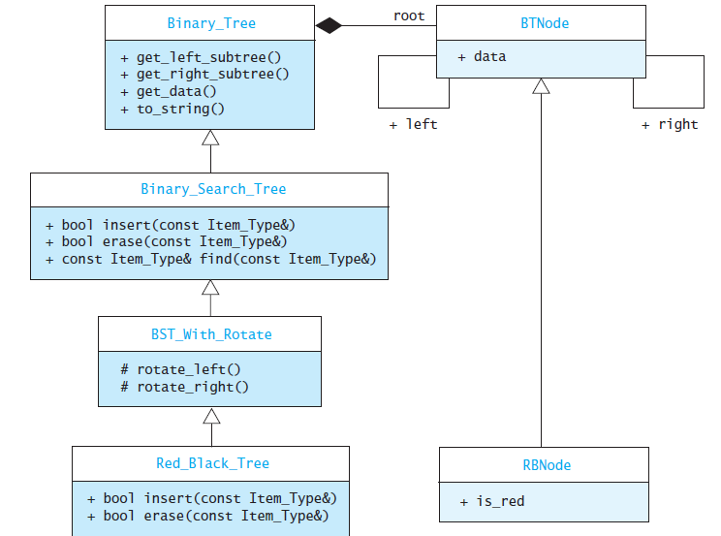
Red-Black Tree Class Implementation

Slide 36
Removal from a Red-Black Tree
Red-Black tree deletion is a fairly complex process.
As with a BST, if a node is a leaf or only has one child, simply remove it.
Otherwise, exchange the node value with the in-order predecessor value and delete the predecessor node.
If the node removed is red, nothing further is done.
The problem with a black node deletion is the change of black height in subtrees as deletion of a black node may cause reduced black height in one root to leaf path.
When a black node is deleted and replaced by a black child, the child is marked as double black (which must be converted to a single black.)
If the node removed is black and has a red child, then the red child takes its place and is colored black.
If a black leaf is removed, the black height becomes unbalanced.
The book describes other cases at the end of the chapter...

Slide 37
Performance of a Red-Black Tree
Empirical studies show that the average cost of searching a Red-Black tree built from random values is 1.002 log₂ n.
Using the three cases, we work our way up the tree and make adjustments as we go.
The upper limit on the height for a Red-Black tree is 2 log₂ n + 2 which is still O(log n).
As with AVL trees, the average performance is significantly better than the worst-case performance.
In general, red-black trees are more efficient than AVL trees.
There is no need to keep track of depth along each branch, like with AVL trees.
Red-Black trees and AVL trees both give performance close to the performance of a complete binary tree.
Red-Black Trees vs. AVL Trees
Insertion and removal are faster for Red-Black trees.
Retrieval is faster for AVL trees.

Slide 38
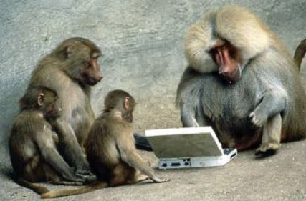
Be Safe

